Slide 1

Housing prices
TEAM#4
Vincent Wai Yeung Tsui
Raymon Matiling
Jeffrey Che
Nadine Blaik

Slide 2

How can we use different housing attributes to predict the sale price ?

Slide 3
Data Set Overview
The team used a set of Ames housing data that had 2000 rows and 83 different columns to train our machine-learning model to answer our business question of predicting housing prices.
The 83 different columns of data were reduced to 47 columns from dropping 36 columns of data that were seen as less of an influencing factor, such as:
Month sold
Misc Value
Sale Condition

Slide 4
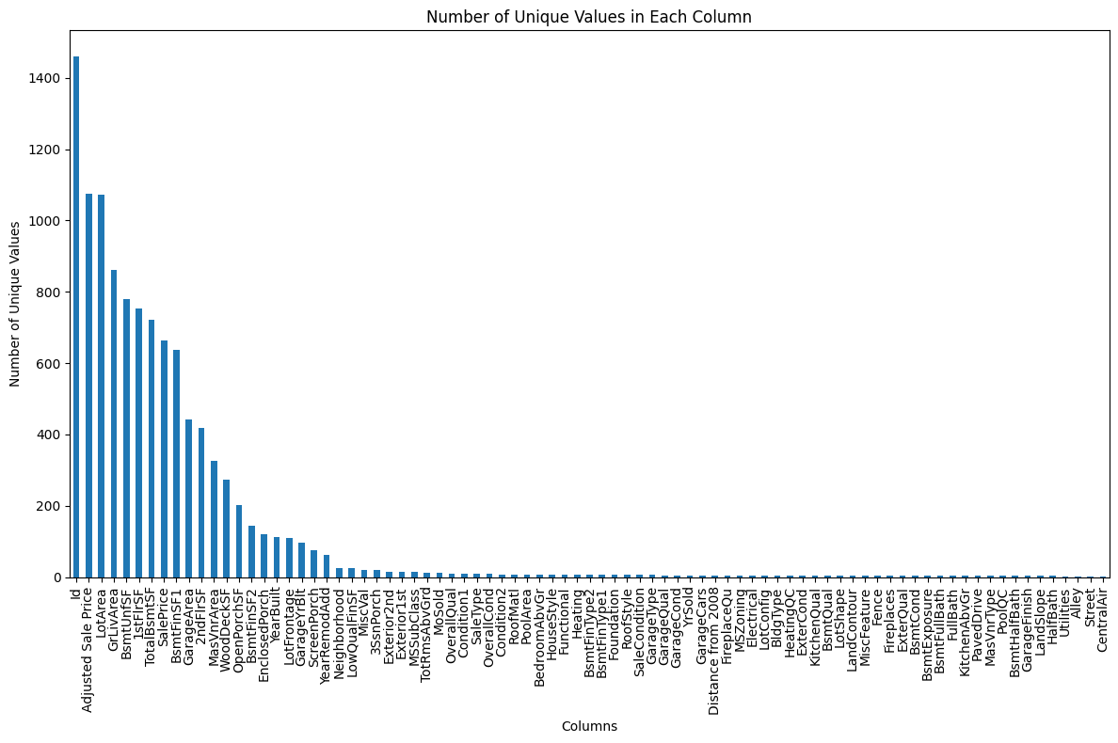
Exploring the Diversity of Data: Visualization of Unique Values in Each Column
This provides a comprehensive overview of the uniqueness present within each column of our dataset. Each bar represents a specific column, with its height indicating the count of unique values within that column. The descending order of bars facilitates easy identification of columns with the highest and lowest numbers of unique values. Taller bars signify greater diversity, suggesting a wide range of distinct values, while shorter bars indicate less variation. This visualization offers valuable insights into the richness and complexity of our dataset, guiding subsequent analysis and decision-making processes.
Notes:
As we delve into the intricacies of our dataset, it's essential to understand the breadth and richness of the values present in each column. Our visualization offers a comprehensive overview, with each bar representing a specific column and its height reflecting the count of unique values within that column. This arrangement allows us to easily discern the extent of diversity across our dataset.
Upon examining the graph, we observe columns with taller bars, signifying a high level of diversity and a wide range of unique values. Conversely, columns with shorter bars indicate lower diversity and fewer distinct values. This insight is invaluable as it provides us with a deeper understanding of the complexity inherent in our dataset.
Understanding the diversity of our data holds significant implications for our analysis and decision-making processes. It informs our approach to feature selection, guiding us in identifying and prioritizing the most relevant variables for our analyses. Additionally, it shapes our data preprocessing techniques, enabling us to effectively handle the diverse range of values present in our dataset.

Slide 5
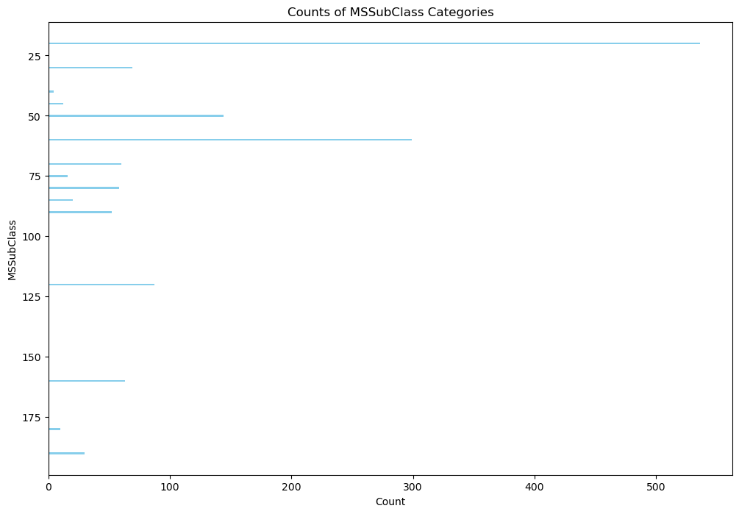
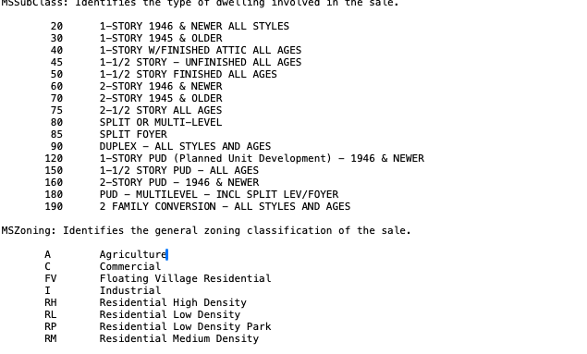
Analyzing Property Types: Distribution of MSSubClass Categories
This graph illustrates the distribution of various property types categorized by MSSubClass within our dataset.
Each horizontal bar represents a specific MSSubClass category, while the length of the bar corresponds to the count of properties belonging to that category.
By examining this visualization, we gain insights into the prevalence of different property types and their relative frequencies within the dataset.
Legend
Notes:
As we delve into the graph displayed before us, we witness a visual representation of the prevalence of different property types within our dataset.
Each bar signifies a specific MSSubClass category, with its length reflecting the count of properties falling under that category. This insightful visualization enables us to understand the distribution of property types and their relative frequencies, shedding light on the diverse array of properties present in our dataset.
By analyzing this graph, we gain valuable insights that inform our understanding of property characteristics and aid us in making informed decisions.

Slide 6
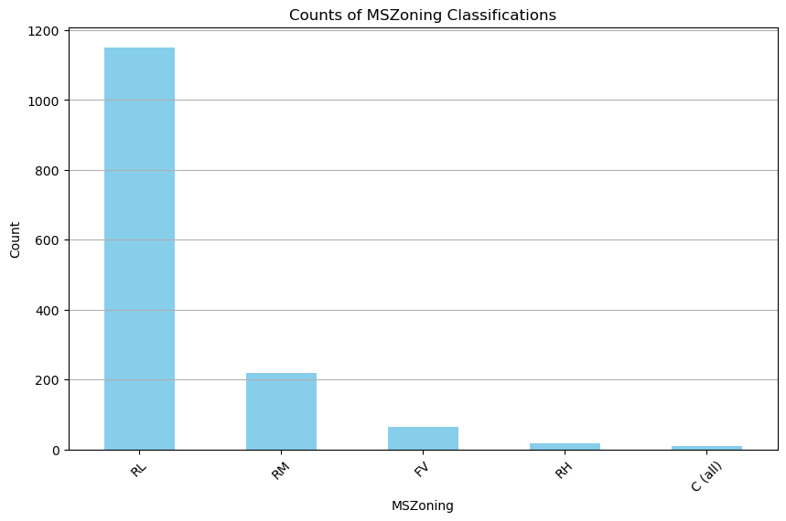
Exploring Zoning Classifications: Distribution of MSZoning Categories
The bar chart visually represents the number of properties categorized under each zoning type. Taller bars indicate a higher prevalence of a particular zoning type in the dataset, providing a clear, comparative view of zoning distributions. The variety of bars shows the diversity of zoning types within the area covered by the dataset. This could indicate a region with a mix of agricultural, residential, commercial, and potentially industrial areas.
For urban planners and developers, understanding the distribution of zoning types is crucial for strategic planning, development, and resource allocation. For example, areas with high residential density might need more infrastructure development such as schools, parks, and roads. And for Real estate professionals it can identify opportunities for development or investment. For instance, a predominance of commercial zones could indicate potential for business real estate developments.

Slide 7
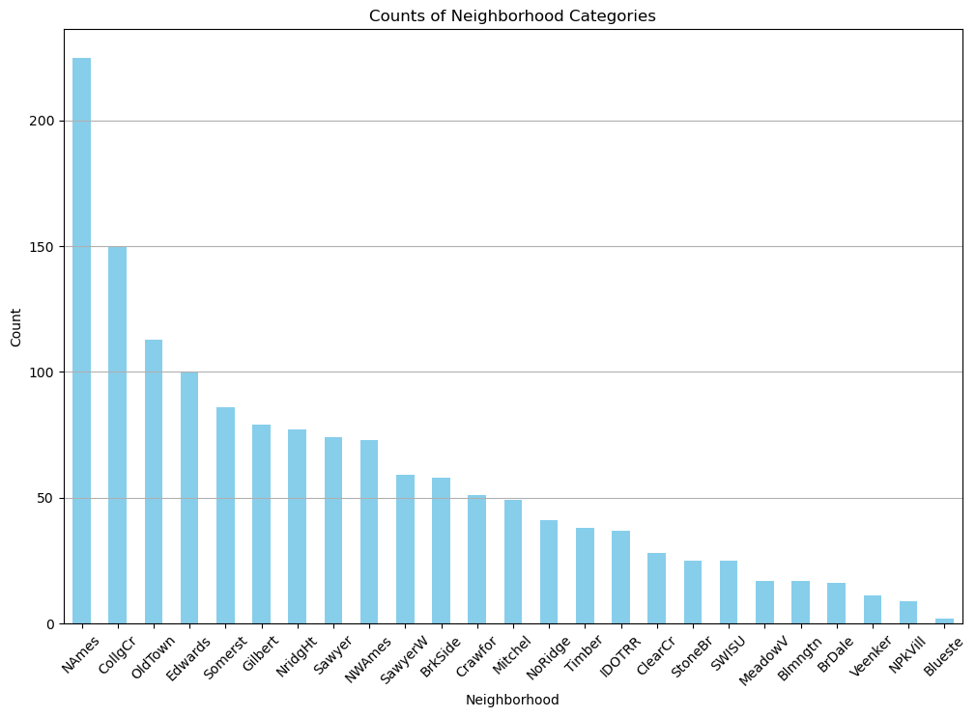
Exploring Neighborhoods: Distribution of Property Counts by Neighborhood
The bar chart effectively displays the number of properties in each neighborhood, with each bar representing a different neighborhood. Taller bars suggest a higher concentration of properties, indicating popular or densely populated areas within the dataset's scope. Neighborhoods with higher counts might be more desirable, possibly due to better amenities, schools, safety, or other attractive features. Conversely, neighborhoods with fewer properties might be less developed or less popular among homebuyers.

Slide 8
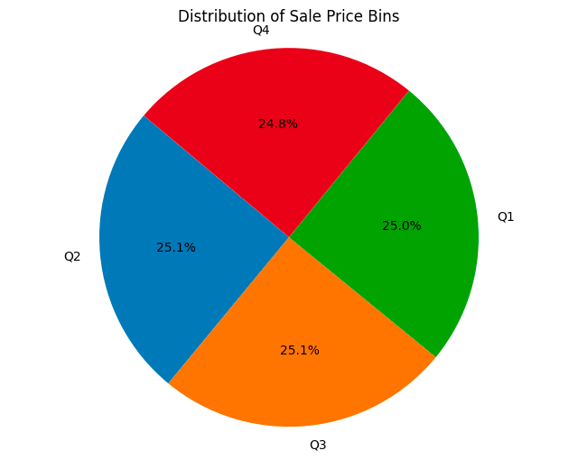
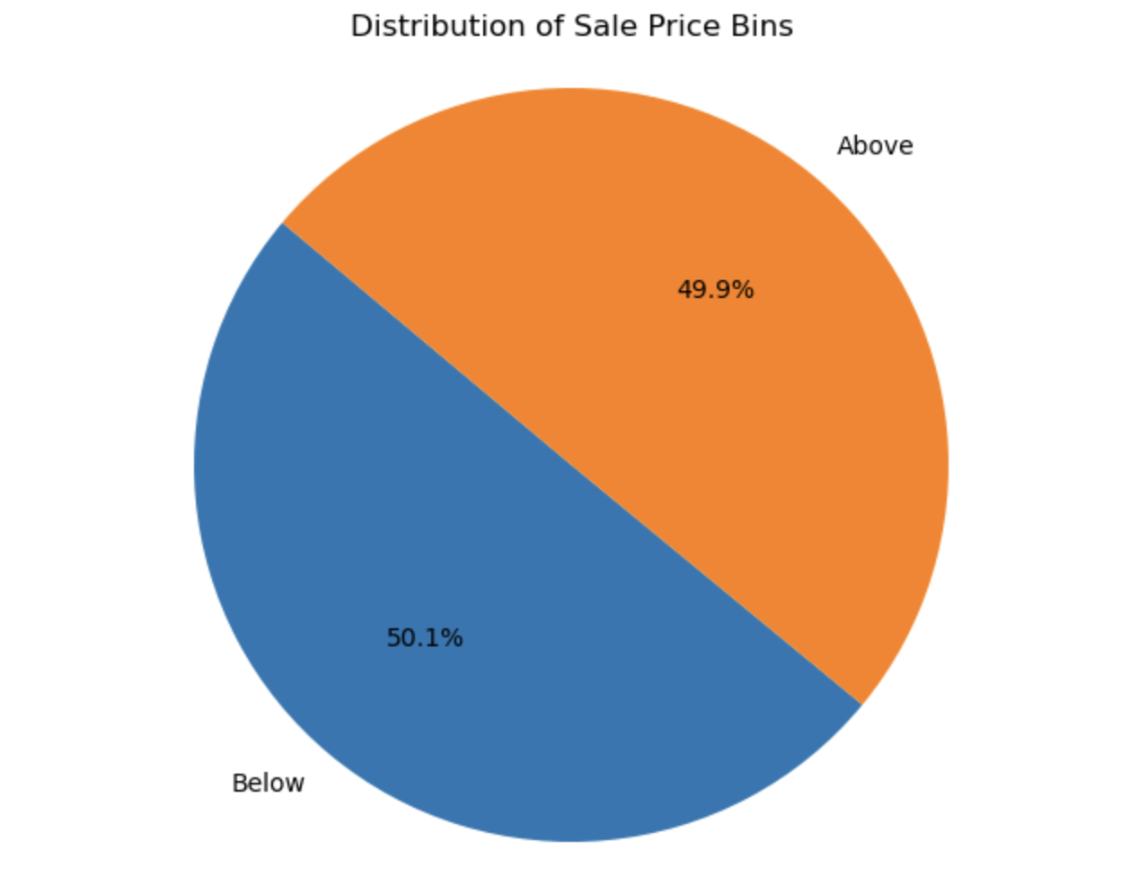
Initial Methodology
A categorization approach was used where different housing prices were bucketed into four different quartiles and as above avg or below avg.
The goal of the neuro network was to see if, based on the different features of a property, the network can correctly predict which quartile the housing price would belong to.

Slide 9
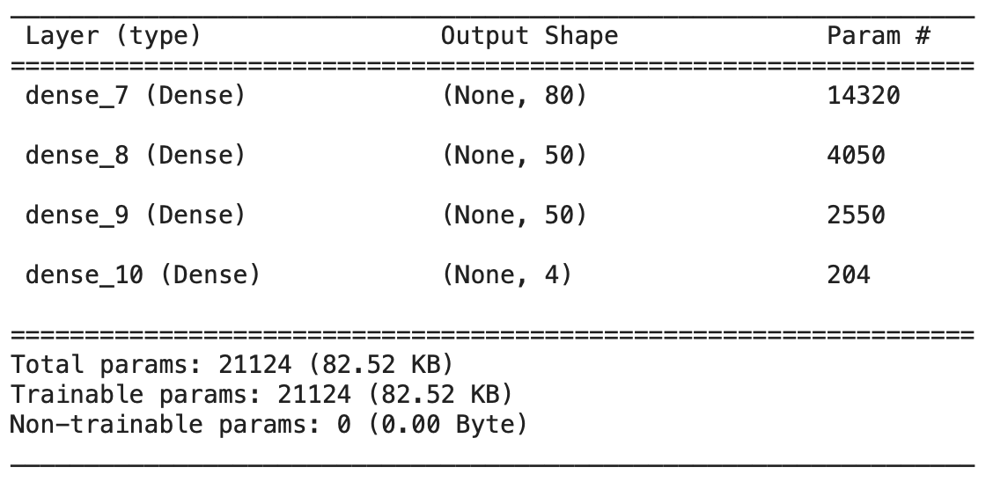
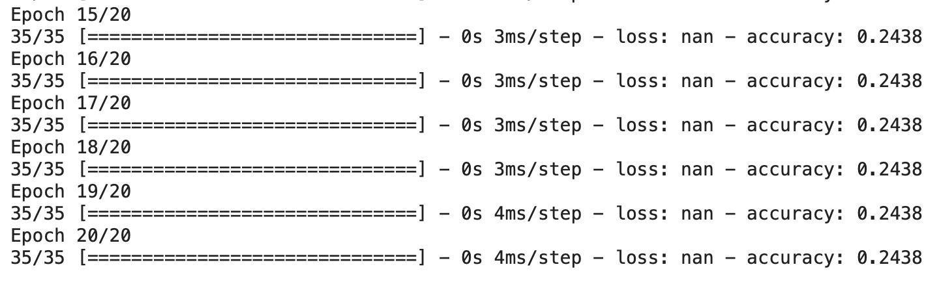
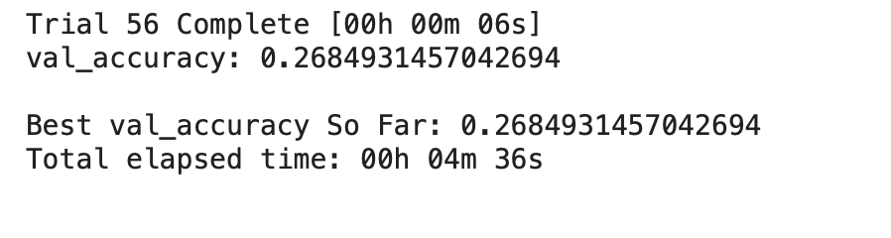
Structure of the Model
Neuro Network Modeling
Attempt 1 Four Quartiles
Features and target array Split:
Y =4 Different Types of SalesBins
X =Rest of the data
Insights:
The model was inaccurate due to the small sample size of the data and the multiple categorizations.
Using kerastuner we searched for the best hyperparameters to further optimize the model but could not produce a higher accuracy.
Training the Model
Model Optimizations
Model Accuracy

Slide 10
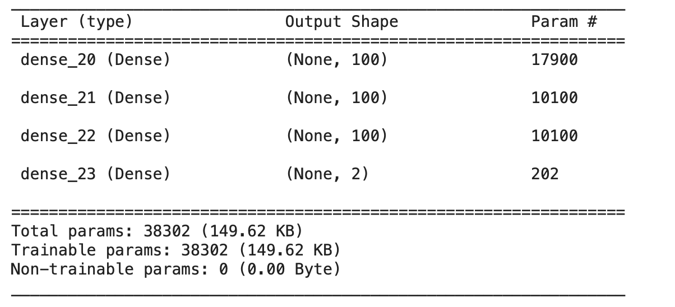
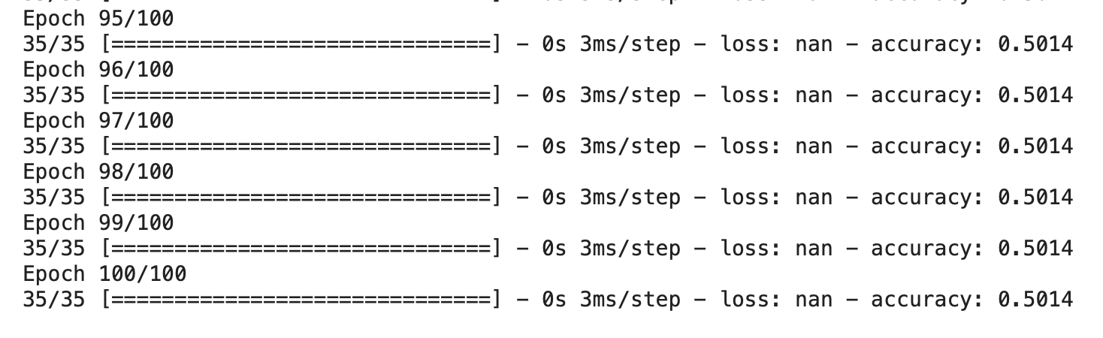
Neuro Network Modeling
Attempt 2 Above and Below Avg
Structure of the Model
Features and target array Split:
Y =Above Avg , Below Avg
X =Rest of the data
Insights:
The model was inaccurate due to the small sample size of the data and the multiple categorizations.
Accuracy is less than a coin flip
Training the Model
Model Accuracy

Slide 11
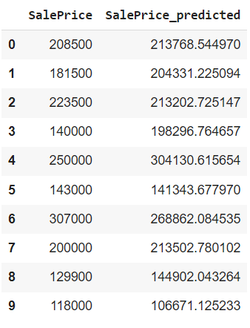
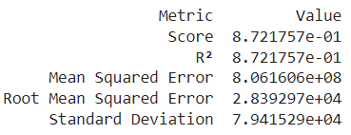
Linear Regression Modeling
Features and target array Split:
Y =Sale Price
X =Rest of the data
Insights:
Large number of features(47 columns)
Small number of rows(1500)
R^2 value is 0.87
- The model explains 87% of the data.
Results:
Predicted Values

Slide 12
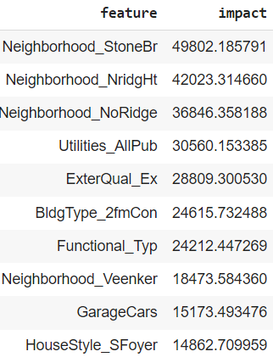
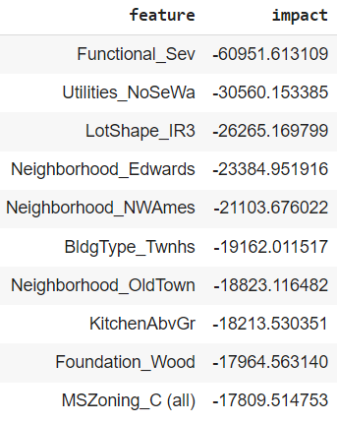
Linear Regression Feature Analysis by Slope
Features:
Important Features:
Neighborhood
Utilities
Exterior Quality
Building Type (Duplex, townhouse...)
Functional (Damage)

Slide 13
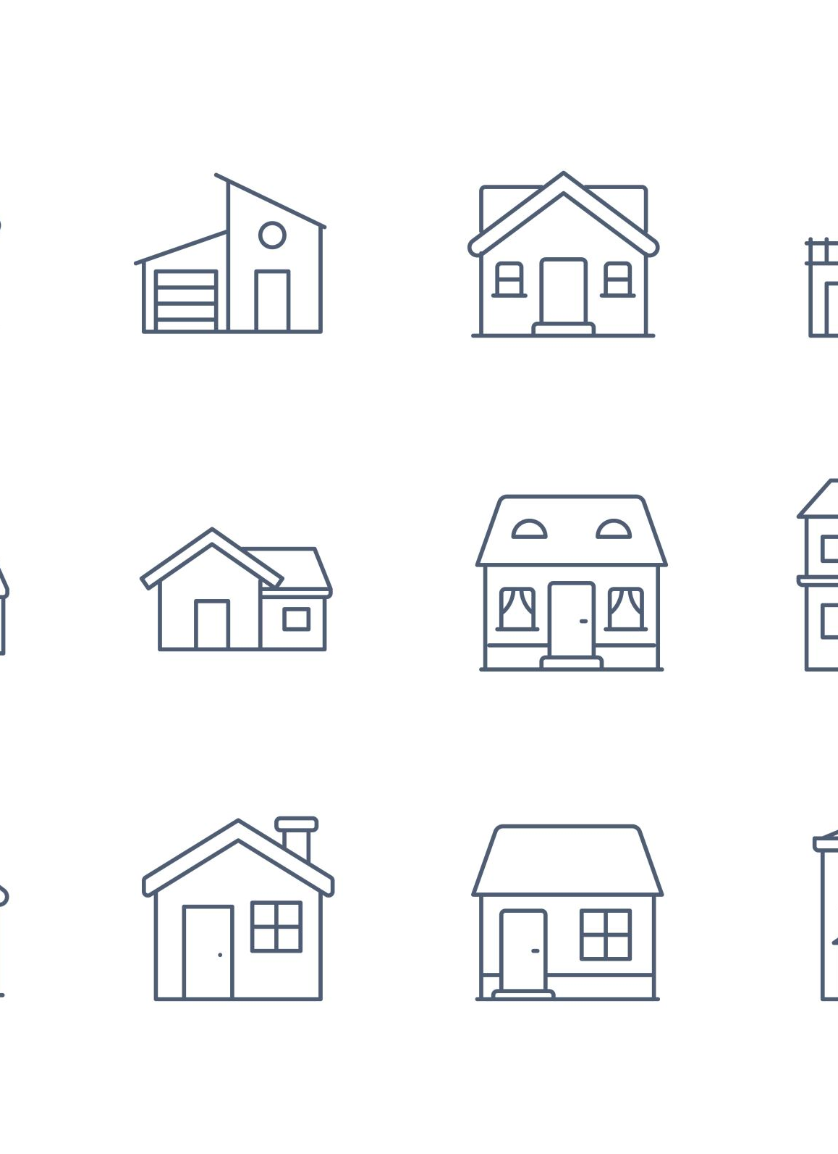
Conclusion
- Linear Regression over performed Neuro Network with our dataset.
Good Qualities:
Located in a demanding Neighborhood
All public Utilities Included (Water, Gas, Electricity)
Exterior In Good Condition
Two-family Conversion
No Damage

Slide 14
Q & A

